Slide 1



Intro to implementing OAuth 2
with Spring Security

Slide 2






laurspilca.com/blog
youtube.com/c/laurentiuspilca
@laurspilca
Laurentiu Spilca
Notes:
Elements (version 1)
Elements are used to give more detail to a set of ideas, they should all relate to the same topic.
For example, use this page for a list of deliverables, key roles on a project, phases of a project, or any topic that can be broken down into more specific examples.
Each section should have an icon that relates to the content of that specific element, no icon should be repeated on the same page, and they should all be the same colour.
Keep the text to 1-2 sentences and aim to have about the same amount of content under each element.

Slide 3
AGENDA
Intro to OAuth 2
Grant types
Tokens
Validating the token
Demo
Kahoot
Final Q&A
Notes:
Elements (version 1)
Elements are used to give more detail to a set of ideas, they should all relate to the same topic.
For example, use this page for a list of deliverables, key roles on a project, phases of a project, or any topic that can be broken down into more specific examples.
Each section should have an icon that relates to the content of that specific element, no icon should be repeated on the same page, and they should all be the same colour.
Keep the text to 1-2 sentences and aim to have about the same amount of content under each element.

Slide 4

INTRO
What is OAuth 2?
1
Notes:
Chapter Intro Slide (version P)
This slide should be used at the beginning of each “chapter” of your presentation (as introduced in the Agenda slide) to keep the audience aware of their place in the story and to help break things up. Change the text and chapter number accordingly. If you do not need a sub-head (the smaller text), delete it. Use different backgrounds for different chapter titles, try not to repeat a background.
Very short presentations (< ~10 slides) may not need Chapter Intro Slides.
There are multiple versions of this template with various white and black background images starting on slide 10.

Slide 5
OAuth 2 is …
An authorization specification framework
NOT an implementation
Helping to simply and correctly separate the authentication and authorization responsibilities in a system
Notes:
Elements (version 1)
Elements are used to give more detail to a set of ideas, they should all relate to the same topic.
For example, use this page for a list of deliverables, key roles on a project, phases of a project, or any topic that can be broken down into more specific examples.
Each section should have an icon that relates to the content of that specific element, no icon should be repeated on the same page, and they should all be the same colour.
Keep the text to 1-2 sentences and aim to have about the same amount of content under each element.

Slide 6
OAUTH 2 RESPONSIBILITIES
The OAuth 2 actors
1
Notes:
Chapter Intro Slide (version P)
This slide should be used at the beginning of each “chapter” of your presentation (as introduced in the Agenda slide) to keep the audience aware of their place in the story and to help break things up. Change the text and chapter number accordingly. If you do not need a sub-head (the smaller text), delete it. Use different backgrounds for different chapter titles, try not to repeat a background.
Very short presentations (< ~10 slides) may not need Chapter Intro Slides.
There are multiple versions of this template with various white and black background images starting on slide 10.

Slide 7
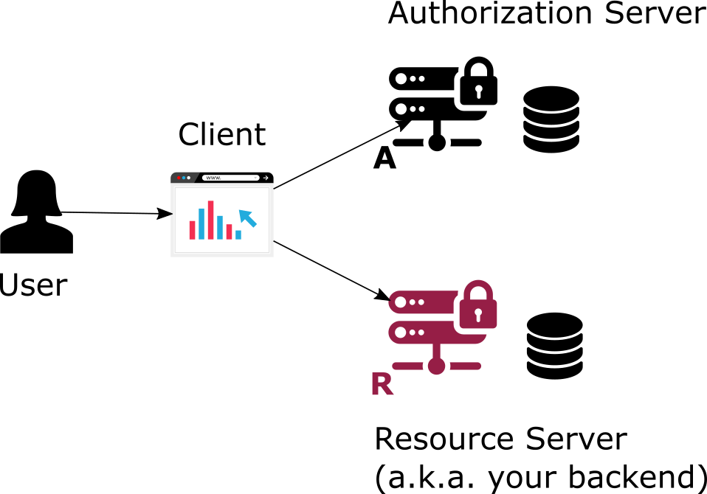
Notes:
Elements (version 1)
Elements are used to give more detail to a set of ideas, they should all relate to the same topic.
For example, use this page for a list of deliverables, key roles on a project, phases of a project, or any topic that can be broken down into more specific examples.
Each section should have an icon that relates to the content of that specific element, no icon should be repeated on the same page, and they should all be the same colour.
Keep the text to 1-2 sentences and aim to have about the same amount of content under each element.

Slide 8
Two important sides
The two important sides of the problem
1
Notes:
Chapter Intro Slide (version P)
This slide should be used at the beginning of each “chapter” of your presentation (as introduced in the Agenda slide) to keep the audience aware of their place in the story and to help break things up. Change the text and chapter number accordingly. If you do not need a sub-head (the smaller text), delete it. Use different backgrounds for different chapter titles, try not to repeat a background.
Very short presentations (< ~10 slides) may not need Chapter Intro Slides.
There are multiple versions of this template with various white and black background images starting on slide 10.

Slide 9
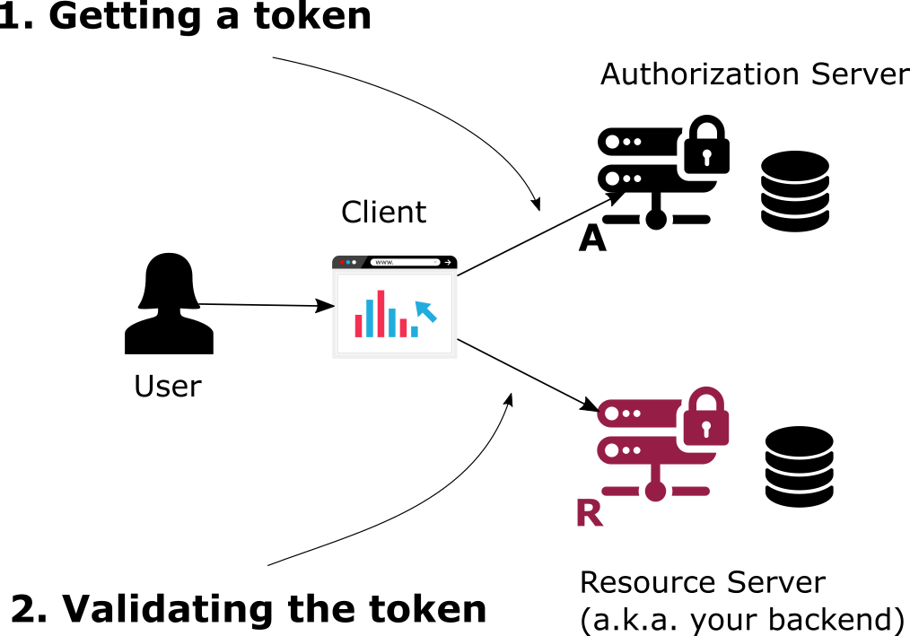
Notes:
Elements (version 1)
Elements are used to give more detail to a set of ideas, they should all relate to the same topic.
For example, use this page for a list of deliverables, key roles on a project, phases of a project, or any topic that can be broken down into more specific examples.
Each section should have an icon that relates to the content of that specific element, no icon should be repeated on the same page, and they should all be the same colour.
Keep the text to 1-2 sentences and aim to have about the same amount of content under each element.

Slide 10
Tokens
Token implementations
1
Notes:
Chapter Intro Slide (version P)
This slide should be used at the beginning of each “chapter” of your presentation (as introduced in the Agenda slide) to keep the audience aware of their place in the story and to help break things up. Change the text and chapter number accordingly. If you do not need a sub-head (the smaller text), delete it. Use different backgrounds for different chapter titles, try not to repeat a background.
Very short presentations (< ~10 slides) may not need Chapter Intro Slides.
There are multiple versions of this template with various white and black background images starting on slide 10.

Slide 11
OPAQUE
NON-OPAQUE (JWT)
Notes:
Elements (version 1)
Elements are used to give more detail to a set of ideas, they should all relate to the same topic.
For example, use this page for a list of deliverables, key roles on a project, phases of a project, or any topic that can be broken down into more specific examples.
Each section should have an icon that relates to the content of that specific element, no icon should be repeated on the same page, and they should all be the same colour.
Keep the text to 1-2 sentences and aim to have about the same amount of content under each element.

Slide 12
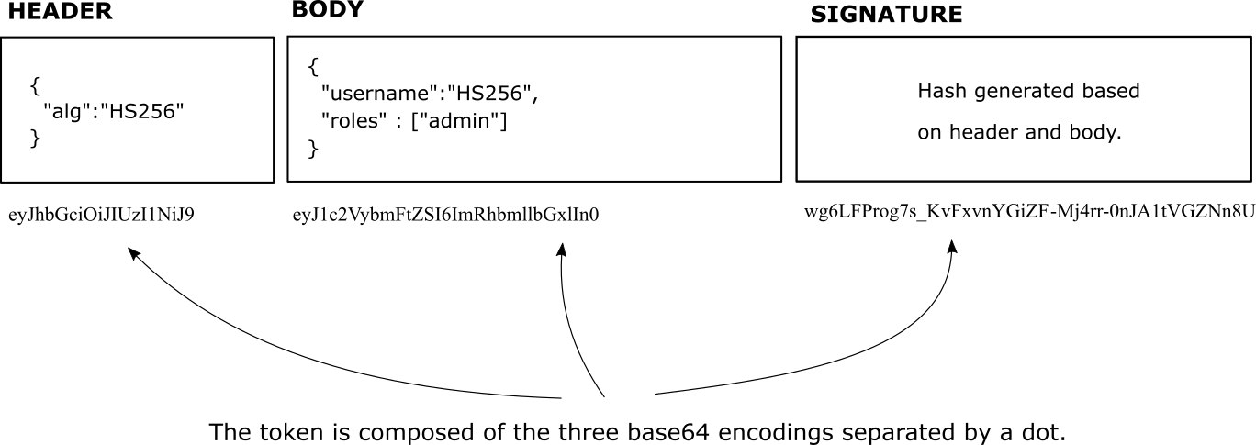
JWT
Notes:
Elements (version 1)
Elements are used to give more detail to a set of ideas, they should all relate to the same topic.
For example, use this page for a list of deliverables, key roles on a project, phases of a project, or any topic that can be broken down into more specific examples.
Each section should have an icon that relates to the content of that specific element, no icon should be repeated on the same page, and they should all be the same colour.
Keep the text to 1-2 sentences and aim to have about the same amount of content under each element.

Slide 13
Grant Types
How to get an access token?
1
Notes:
Chapter Intro Slide (version P)
This slide should be used at the beginning of each “chapter” of your presentation (as introduced in the Agenda slide) to keep the audience aware of their place in the story and to help break things up. Change the text and chapter number accordingly. If you do not need a sub-head (the smaller text), delete it. Use different backgrounds for different chapter titles, try not to repeat a background.
Very short presentations (< ~10 slides) may not need Chapter Intro Slides.
There are multiple versions of this template with various white and black background images starting on slide 10.

Slide 14
Grant Types
IMPLICIT (DEPRECATED)
AUTHORIZATION CODE (with/without PKCE)
PASSWORD (TO AVOID)
CLIENT CREDENTIALS
REFRESH TOKEN
Notes:
Elements (version 1)
Elements are used to give more detail to a set of ideas, they should all relate to the same topic.
For example, use this page for a list of deliverables, key roles on a project, phases of a project, or any topic that can be broken down into more specific examples.
Each section should have an icon that relates to the content of that specific element, no icon should be repeated on the same page, and they should all be the same colour.
Keep the text to 1-2 sentences and aim to have about the same amount of content under each element.

Slide 15
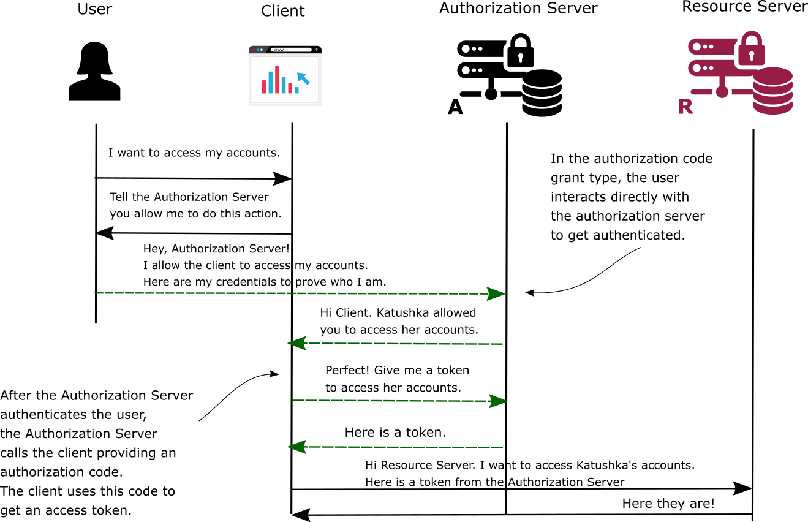
Notes:
Elements (version 1)
Elements are used to give more detail to a set of ideas, they should all relate to the same topic.
For example, use this page for a list of deliverables, key roles on a project, phases of a project, or any topic that can be broken down into more specific examples.
Each section should have an icon that relates to the content of that specific element, no icon should be repeated on the same page, and they should all be the same colour.
Keep the text to 1-2 sentences and aim to have about the same amount of content under each element.

Slide 16
Authorization
How to validate the access tokens?
1
Notes:
Chapter Intro Slide (version P)
This slide should be used at the beginning of each “chapter” of your presentation (as introduced in the Agenda slide) to keep the audience aware of their place in the story and to help break things up. Change the text and chapter number accordingly. If you do not need a sub-head (the smaller text), delete it. Use different backgrounds for different chapter titles, try not to repeat a background.
Very short presentations (< ~10 slides) may not need Chapter Intro Slides.
There are multiple versions of this template with various white and black background images starting on slide 10.

Slide 17
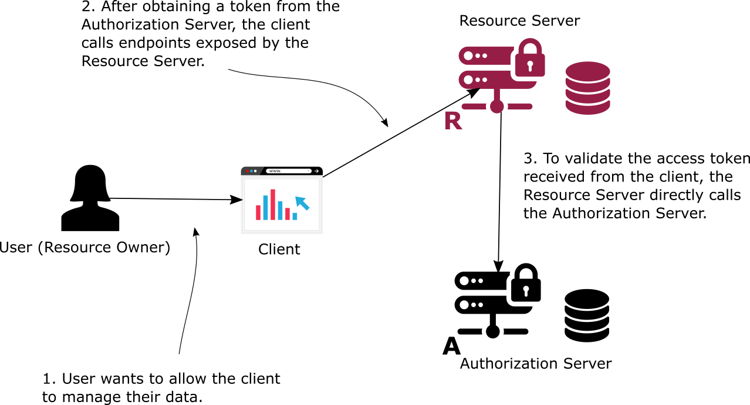
INTROSPECTION
Notes:
Elements (version 1)
Elements are used to give more detail to a set of ideas, they should all relate to the same topic.
For example, use this page for a list of deliverables, key roles on a project, phases of a project, or any topic that can be broken down into more specific examples.
Each section should have an icon that relates to the content of that specific element, no icon should be repeated on the same page, and they should all be the same colour.
Keep the text to 1-2 sentences and aim to have about the same amount of content under each element.

Slide 18
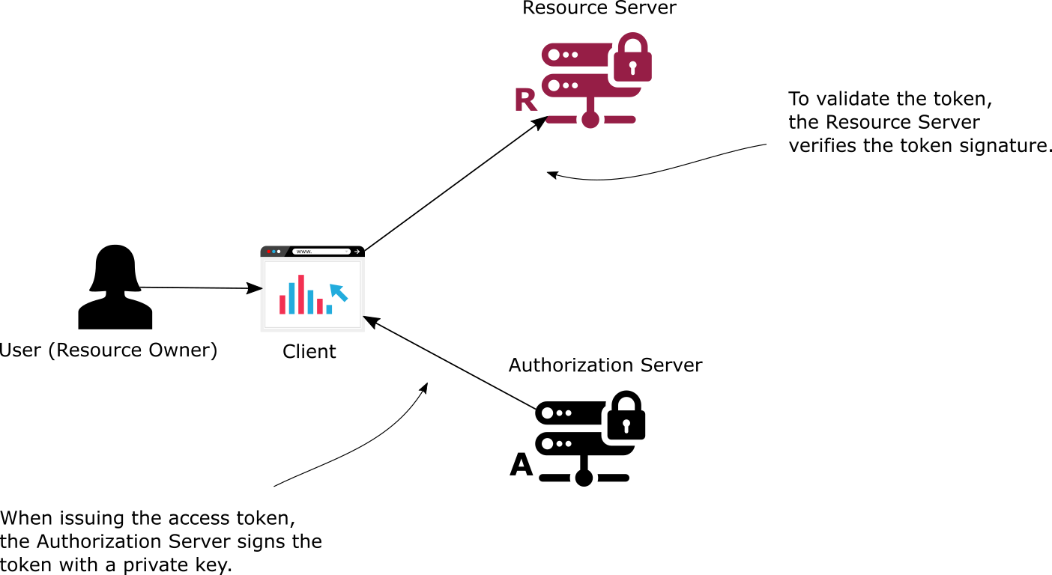
CRYPTO SIGNATURES
Notes:
Elements (version 1)
Elements are used to give more detail to a set of ideas, they should all relate to the same topic.
For example, use this page for a list of deliverables, key roles on a project, phases of a project, or any topic that can be broken down into more specific examples.
Each section should have an icon that relates to the content of that specific element, no icon should be repeated on the same page, and they should all be the same colour.
Keep the text to 1-2 sentences and aim to have about the same amount of content under each element.

Slide 19
DEMO
Hands-on implementing a flow with Spring Security
1
Notes:
Chapter Intro Slide (version P)
This slide should be used at the beginning of each “chapter” of your presentation (as introduced in the Agenda slide) to keep the audience aware of their place in the story and to help break things up. Change the text and chapter number accordingly. If you do not need a sub-head (the smaller text), delete it. Use different backgrounds for different chapter titles, try not to repeat a background.
Very short presentations (< ~10 slides) may not need Chapter Intro Slides.
There are multiple versions of this template with various white and black background images starting on slide 10.

Slide 20
WHERE TO NEXT?
Learning resources
1
Notes:
Chapter Intro Slide (version P)
This slide should be used at the beginning of each “chapter” of your presentation (as introduced in the Agenda slide) to keep the audience aware of their place in the story and to help break things up. Change the text and chapter number accordingly. If you do not need a sub-head (the smaller text), delete it. Use different backgrounds for different chapter titles, try not to repeat a background.
Very short presentations (< ~10 slides) may not need Chapter Intro Slides.
There are multiple versions of this template with various white and black background images starting on slide 10.

Slide 21


youtube.com/c/laurentiuspilca
laurspilca.com/blog

Slide 22
KAHOOT!
1
Notes:
Chapter Intro Slide (version P)
This slide should be used at the beginning of each “chapter” of your presentation (as introduced in the Agenda slide) to keep the audience aware of their place in the story and to help break things up. Change the text and chapter number accordingly. If you do not need a sub-head (the smaller text), delete it. Use different backgrounds for different chapter titles, try not to repeat a background.
Very short presentations (< ~10 slides) may not need Chapter Intro Slides.
There are multiple versions of this template with various white and black background images starting on slide 10.

